Slide 1
Creative Process Pre-work
Launch Summer 2015

Slide 2


Introduction
This deck will guide you through your creative process brainstorming and ideation mandatory pre-work before 2015 Launch Summer Program.
Is an individual assignment
Designed to be completed over a minimum of 7 days
Consists of three steps:
discovery,
filtering, and
analysis
This deck provides a quick knowledge brief as well as step-by-step guide to assist you with the pre-work. Pay attention to these icons:
Quick knowledge brief
Step-by-step guide to complete the pre-work
Should you have any questions, please do not hesitate to contact the Launch team at areen@mit.edu. Good luck and see you soon this summer!

Slide 3
Overview of this deck
Overview of the process
Discovery – coming up with ideas
What’s going on in the world
Determine your interest area(s)
Ways of finding opportunities:
Needs
Gaps
Trends
Turning needs, gaps, and trends into ideas
Examples of ideation in some interest areas
Activities to brainstorm your 20-30 ideas
Filtering – assess the ideas and choose the top 5 based on:
Fit – something you would be excited to work on
Potential – an idea with good customer, competitive, and value potential
Analysis – perform further research on the top 5 ideas
Submit!

Slide 4





1. Overview of the process
1
Day 1-4 (or more)
Day 5
Day 6-7
2
3
Discovery
Filtering
Analysis
Summer Program
Customers
“Make it real”
Competition
Feasibility
Come up with 20-30 ideas (go for quantity)…
… through knowing your interest areas…
…identifying needs, gaps, and trends…
… and solving them!
Prioritize business ideas to identify your top 5 ideas based on:
Fit
Potential
Detail out your top 5 business ideas along three dimensions:
Customers
Competition
Feasibility
Submit 20-30 ideas
Submit prioritization
and top 5 business ideas
Submit detail of
top 5 business ideas
Submit assignment to Edmodo

Slide 5

Take Notes Throughout!
Use your MIT Launch notebook to capture your
Notes
Thoughts
Ideas
Everything!
Starting with the next section (2a) – take note of what trends going on in the world appeal to you, that you would most like to work on
Please note that the discovery process of business ideas doesn’t end here!
You will bring your top ideas to Launch, brainstorm with people of similar interests, and choose an idea and teammates with complementary skills, values, and interests.

Slide 6






2a. What’s going on in the world
1
Discovery
Top Startup Trends
(Source: http://www.businessinsider.com/andreessen-horowitz-startup-trends-2015-1 )
Virtual Reality
Machine Learning and Big Data
Containers
Digital Health
Online Marketplaces
Bitcoin
Crowdfunding
The Internet of Things

Slide 7





2a. What’s going on in the world
1
Discovery
Top 10 Global Agenda Trends 2015
(Source: http://reports.weforum.org/outlook-global-agenda-2015/ )
Income inequality
Persistent jobless growth
Lack of leadership
Rising geostrategic competition
Weakening of representative democracy
Rising pollution in the developing world
Increasing occurrence of severe weather events
Intensifying nationalism
Increasing water stress
Growing importance of health in the economy

Slide 8

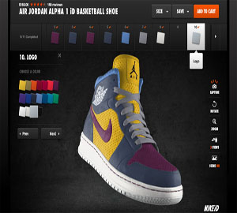
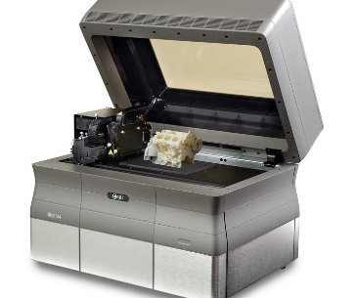

2a. What’s going on in the world
1
Discovery
Selected global trends for finding opportunities
(Source: http://www.economist.com/blogs/theworldin2013/2012/11/global-trends-2013 )
Social everything
Redefining value – consumers have choice
(mass customization)
Distributed everything – mobility in production and consumption
(3D printing, online learning, etc)
More: http://www.smallbizlabs.com/2014/12/top-10-small-business-trends-for-2015.html
Top 10 Disruptive Macro Trends In Market Research For 2015
(Source: http://www.greenbookblog.org/2015/02/02/the-top-10-disruptive-macro-trends-in-market-research-for-2015/ )
Trend: Increased consumer sophistication
Consumers have greater access to information + more specialization of interests and needs
Impacts:
Transition to insights
Commoditization of and consolidation of market research, big data synthesis
Increase in DIY (do it yourself)

Slide 9
2b. Determine your interest area(s)
1
Discovery
Based on what stood out to you on the last few pages, plus what interests you in your other activities and daily life, determine what your industry and business innovation interest area(s) is(are)
 | Mobile / tech | Financial services | Lifestyle (fashion, music, arts, etc) | Transportation, housing, and logistics | Consumer goods and services | Food and beverage | Energy / clean energy | Education | Healthcare
Product
Service / platform
App / mobile

Slide 10






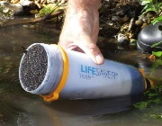









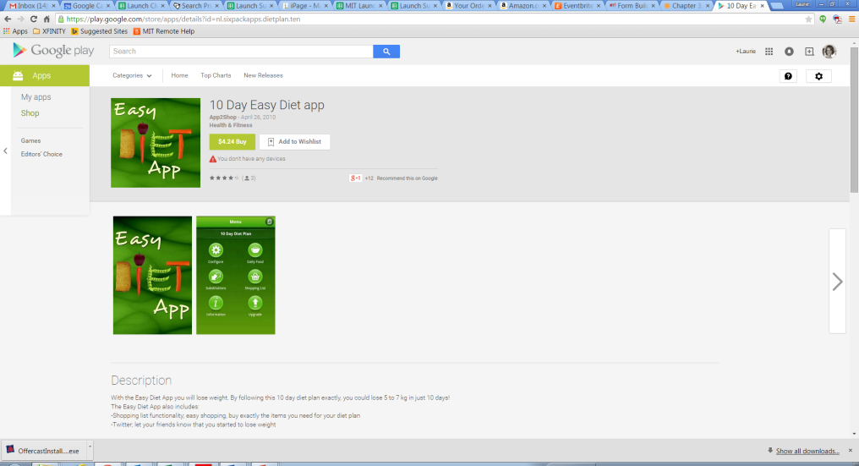
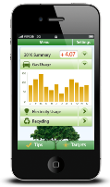
2b. Determine your interest area(s)
1
Discovery
Examples might include:
 | Mobile / tech | Financial services | Lifestyle (fashion, music, arts, etc) | Transportation, housing, and logistics | Consumer goods and services | Food and beverage | Energy / clean energy | Education | Healthcare
Product
Service / platform
App / mobile

Slide 11
2c. Ways of finding opportunities: needs, gaps, and trends
1
Discovery
Needs: Needs are ways that current customers of the market are being underserved relative to their desired conditions. A needs assessment can be used to determine and address the discrepancy between the current condition and desired condition. Needs can often be assessed by interviewing customers about their needs and frustrations.
Gaps: Gaps represent opportunities to appeal to a specific niche group of customers in a more specialized way. These can be assessed by determining where certain customers are underserved in the market by not having the skills or access to current offerings.
Trends: Trends are recent developments that enable new markets to emerge, such as trends towards things becoming mobile, crowdsourcing of ideas and content, mass customization, etc. General business trends can be assessed for relevance in an industry, or specific trends in the industry can be looked up to determine how best to capitalize.

Slide 12
2ca. Ways of finding opportunities: needs
1
Discovery
Needs: Needs are ways that current customers of the market are being underserved relative to their desired conditions. A needs assessment can be used to determining and addressing the discrepancy between the current condition and desired condition.
Ways of performing a needs assessment:
Listen to your customers – Determine ideal customers in the segment and interview them about their needs and frustrations. Be sure not to be leading – ask open ended questions
Watch your competitors – Look at both top companies and newly hyped companies in the industry and assess their strengths and weaknesses. Ask some passionate customers about ways that they wish the offerings served them better.
Keep up with legislation – Check quickly if there are any new governmental regulations that may present any new needs

Slide 13
2cb. Ways of finding opportunities: gaps
1
Discovery
Gaps: Gaps represent opportunities to appeal to a specific niche group of customers in a more specialized way. These can be assessed by determining where certain customers are underserved in the market by not having the skills or access to current offerings.
Assessing market gaps:
Choose a specific type of offering or industry category
Determine current customers
Assess barriers to being a customer – Determine if there are certain skills, access, awareness, etc that makes the offering accessible to these customers, but permits it from being desirable or accessible to others
Determine what other customers would adopt – If offerings were easier to use, more accessible, or otherwise barriers lowered, what customers might you want to target. Examples might include
the elderly,
third world countries,
less technologically advanced people,
etc

Slide 14
2cc. Ways of finding opportunities: trends
1
Discovery
Trends: Trends are recent developments that enable new markets to emerge, such as trends towards things becoming mobile, crowdsourcing of ideas and content, mass customization, etc. General business trends can be assessed for relevance in an industry, or specific trends in the industry can be looked up to determine how best to capitalize.
Refer to the “trends” pages earlier in this deck
Lookup trends specific to the industry in which you are interested

Slide 15
2d. Turning needs, gaps, and trends into ideas
1
Discovery
Interest Areas
Choose your areas of interest:
Industries
Type of business
Interesting Trends
Assess what trends interest you
More generally
Industry specific
Need, Gap, or Trend
Look for needs, gaps, and trends in this area:
Needs: interview customers, assess strengths and weaknesses of top industry players
Gaps: determine new potential customers or barriers to becoming a customer and how to reduce those barriers
Trends: assess additional trends
Idea
Develop a preliminary idea of how to solve the need, fill the gap, or take advantage of the trend
Note: Examples on the following pages show OUTPUT
business / final chosen idea of the creative process
(versus the full suite of 20-30 ideas an individual might come up with –
a template of what this might look like will be provided later)

Slide 16

2e. Examples of ideation output
1
Discovery
Interest Areas
Tech
Platforms / services
Education
Product or Service
Interesting Trends
3D printing
Online / cloud computing, mobility in working in teams
3D printing
Need, Gap, or Trend
Gap – people who want to 3D print but don’t have the 3D CAD tech skills
Trend – crowdsourcing
Need/Gap – need for multiple designers, engineers, etc input / edit for a project
Gap – many schools don’t know how to implement a maker space
Trend – hackathons
Gap – not much hardware
Idea
GrabCAD – free online marketplace to upload / download CAD files
Online shared editing of designs, engineering files – “google docs” for engineers / designers
“Maker Space in a Box” specifically for schools
“Makeathons” toolkit

Slide 17


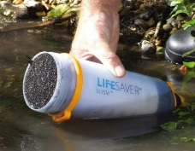
2e. Examples of ideation output
1
Discovery
Interest Areas
Healthcare
Food and beverage
Interesting Trends
Online/mobile allowing increasing automation of activity
Mobility, technology
Online/mobile allowing increasing automation and convenience
Food and water crises
Need, Gap, or Trend
Need: search for doctors and schedule appointments online
Gap: rural third world countries have limited access to medical help
Need: more convenient means of getting groceries
Need: safe drinking water in third world countries
Idea
“Yelp” for doctors
Virtual diagnostics and treatment advice
Online grocery ordering and delivery
Filtration water bottle

Slide 18



2e. Examples of ideation output
1
Discovery
Interest Areas
Lifestyle – fashion, music, art, etc
Service / platform
Energy/Clean Energy
Interesting Trends
Crowdsourcing ideas and content
Sharing of personal items (like through AirBnB)
Mass customization
Pollution-renewable energy
Need, Gap, or Trend
Gap: several startups want custom logo and web designs but cannot afford it
Gap: fashionista women wanting new style dresses for events but unable to afford them
Need: shoes tailored to specific foot features
Need: pure form of fuel cell
Idea
Allow many designers to compete by submitting designs to a brief
Rent designer gowns
FitNFind – take photos of foot and upload to site to get shoes specific to needs
Develop electrolyzers for hydrogen generation

Slide 19



2e. Examples of ideation output
1
Discovery
Interest Areas
Transportation
Housing
Interesting Trends
Increasing city populations, high traffic
Customized housing options, increasing elderly population with desire for independence
Shared personal items / peer to peer
Need, Gap, or Trend
Gap: commuters unable to afford cars but seeking less busy option that public transit
Need: Elderly, people with disability and seniors need affordable and accessible housing options.
Need: Affordable rentals for short period of times
Idea
group commuters
affordable independent living and assisted care services
Rent unique places to stay from local hosts

Slide 20
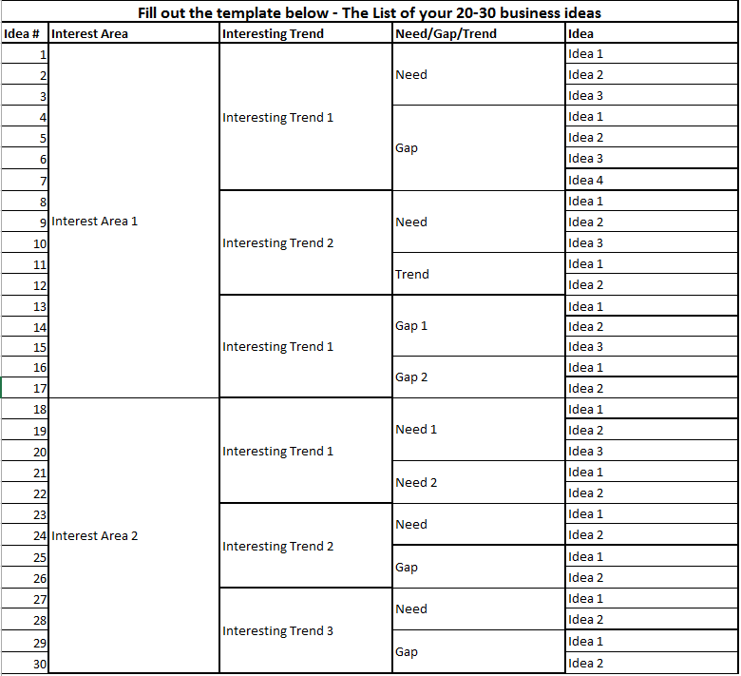
2e. Example of what your ideation template might look like
1
Discovery
List your interest area(s)
And gradually dig deeper with trends, needs, and gaps – with several ideas for each
Include lots of diverse solutions – get creative! Have them range from mild to wild. Revisit the need / gap after a couple days with a fresh perspective

Slide 21
Your to-do guide: Discovery
1
Discovery
1
Go through the sample activities on the following pages and find multiple business ideas for each of them. Stuck on one but have tons in another? That’s fine! We realize that different activities will be inspiring to different people! Target a minimum of 20-30 diverse ideas
Fill out the first tab of the template
2

Slide 22
2f. Activities overview to brainstorm your 20-30 ideas
1
Discovery
Identify your areas/industries of interest
Research the interesting trends in the industry of your interest
Then…
Needs - Assess how current needs are being solved, and what needs aren’t being solved
Your needs
Customer needs – interview 4-5 people who use products in this category
Gaps
Assess existing products
Assess underserved market segments
Trends
Inspiration from existing companies
Inspiration from new technologies

Slide 23
2f1. Assess Market Needs
1
Discovery
“By far the most common mistake startups make is to solve problems no one has.” – Paul Graham
Steps to identifying a market need and developing a solution for it:
List your own frustrations/needs
Identify 4-6 people you know who are customers of your interest area to ask about their frustrations and unmet needs – be sure to get some diversity to the group (ie – not just your high school classmates).
Ask the right questions - focus on asking open-ended questions
For what do they use products / services in this industry?
Can you observe them using the product or service?
Is there anything that would allow them to be able to do that better?
What keeps them from enjoying offerings in this industry more? What features and aspects really annoy them?
What are their favorite parts? What really brings them the most excitement?
What is their biggest waste of time? Waste of money?
What product or service do they wish they had that doesn’t exist yet?
Do additional online research and identify the biggest unmet needs in your areas of interest
Develop a potential solutions (business ideas), then verify your ideas to understand if they are a ‘painkiller’ (solving a real need) or only a ‘vitamin’ (just a ‘nice to have’)
Source: http://www.alleywatch.com/2014/02/how-to-get-startup-ideas-by-interviewing-customers/

Slide 24

2f1. Example of how interviews can lead to ideas
1
Discovery
You may choose to have the customer pick a product or service that you like within the industry
Observe them using the product – see some difficulties / hear some complaints
Determine features and aspects that really annoy them
This makes my hand and
carpet wet
The angle isn’t right! The rain
still comes right through my face!
I can’t hold this for too long.
It’s just too tiring!

Slide 25
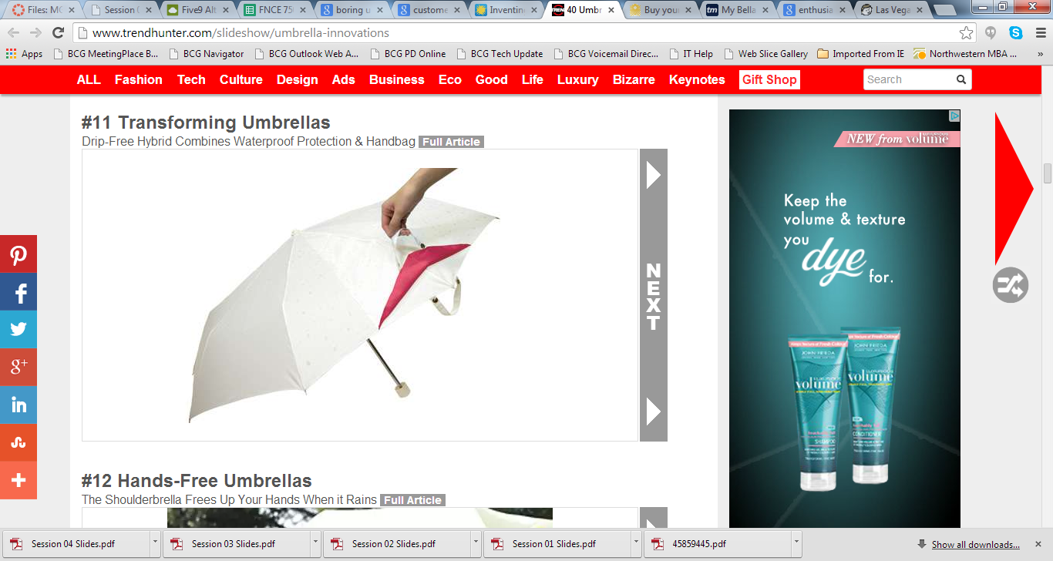

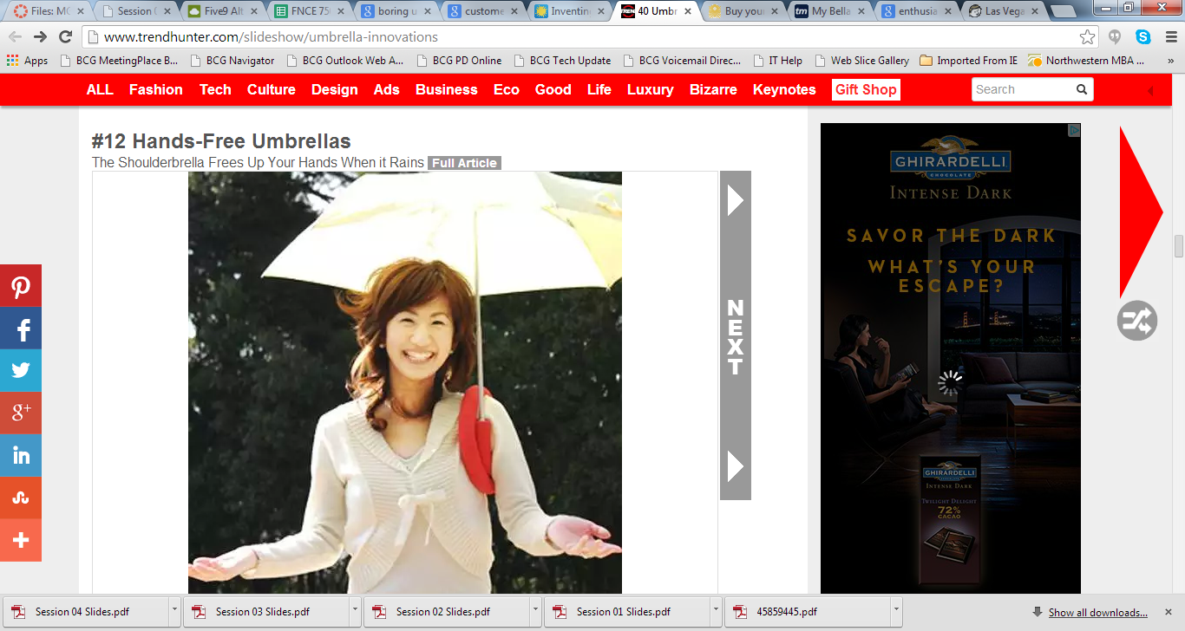
2f1. Example of how interviews can lead to ideas
1
Discovery
Tailoring the product or the market to fit the needs
How might the product or service be made more convenient, cheaper, or catered to one specific feature that better addresses those customer needs?
What do you really want to change? Think of multiple ways to adjust existing products to appeal to a new market or solve existing customers’ needs
Hands-free umbrella
Transforming umbrella
drip-free and waterproof protection
& handbag
No more wet or
flip over umbrella
Your mental filter might be saying: “that seems like a “nice to have” = “vitamin” solution and not a “painkiller” or other such naysaying thoughts… and you may be right, but…
Remember, you are in brainstorming mode, so go for quantity, write them all down!
You’ll filter for quality later…

Slide 26


2f2. Assess Market Gaps
1
Discovery
2 different methods of assessing market gaps and developing ideas to fill them:
First option:
List names of companies in your target industry and what are they trying to solve
List the market segments that are not served or targeted by these companies
How can you serve these underserved segments? What customization does it require?
Second option:
List names of companies in your target industry and what are they trying to solve
Assess any barriers to use: skills, geographic constraints, high costs, etc
Determine who would be an ideal customer segment if one of these barriers could be reduced
Develop a potential solution/offering (business idea), then verify each idea to understand if it’s a ‘painkiller’ or only a ‘vitamin’
Customer
Product / Service

Slide 27
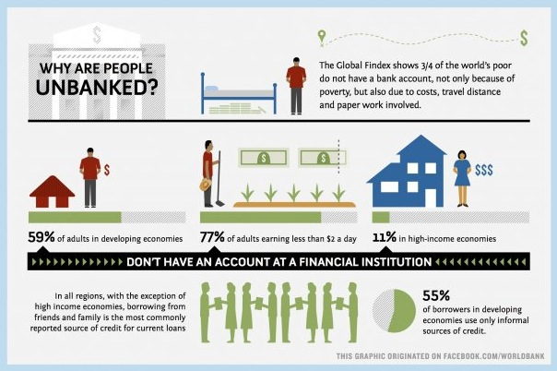

2f2. Gap: Assess existing product - example
1
Discovery
Financial services industry
Are there potential customers for a product or service category that are not being adequately addressed? – people who don’t have an account at a financial institution
Are there any missing key features that the customers would like to have? How would you improve the product to bring it to different market?

Slide 28

2f3. Assess Market Trend
1
Discovery
Steps to developing a business idea based on a market trend:
Research the industry of your interest
List the top trends in the industry of your interest
Find inspiration from top companies in the industry and how they have succeeded
Find inspiration from emerging companies and how they have made a name for themselves
Develop a potential offering (business idea)
TREND: shift towards contract employees and utilization of freelance personnel to fill expertise gaps, as well as roles traditionally performed by full-time employees, to help ease business costs and increase cash flow. In addition, employees are looking for flexible working condition (working from home, deciding what to work on).

Slide 29






2f2. Example of research - inspiration from the food industry
1
Discovery
Your partner in personal nutrition
Discover the best pop-ups and rising chefs around you
Recipes and ingredients delivered each week
Fresh ingredients. Chef-made. Delivered.
Ready when you are.
Ingredients to cook a top Chef recipe
Including videos
Get better deals on your groceries

Slide 30












2f2. Example inspiration from new technologies companies
1
Discovery
The 12 youngest startups that joined the $1 billion club in 2014
http://www.forbes.com/sites/caroltice/2014/12/29/1-billion-in-under-5-years-the-12-hottest-tech-startups/
Free calls and messages everywhere
App-based transportation network
Flash storage
Mobile point-of-sales tools
Online subscription fashion retailer
Enterprise virtualization and storage company
Reverse proxy for websites
Web and mobile payments
Built for developers
Discover and save creative ideas
Home design, decorating, and remodeling
Copy data virtualization
Team communication platform

Slide 31
2f. More Fun Tips to identify Market Needs/Gaps/Trends
1
Discovery
Use Google Trends (http://www.google.com/trends/) to see how the number of searches for a given term has changed over time. It’s an invaluable tool for getting a clear sense of the evolution of a trend or market. Tip: Put in a variety of search terms to see their relative popularity.
Spot Signifiers: have a good understanding of past trends, how and why they occurred. This knowledge will give you the insight you need to spot signifiers and indicators of new trends.
Read Widely: The more information that you can take in and process, the more likely you are to spot an opportunity before it even becomes a trend.
Remember: There’s Room for More Than One: Once one-to-two companies have proven the business is sustainable, it could be a good time to get involved and find your niche. In fact, creating an entirely new market can be extremely difficult and costly.
Scan the Market: Subscribe to RSS feeds, and make a commitment to read relevant articles that affect your industry. It’s important to learn to filter out the background noise so you can spot the meaningful trends in the market that are taking place. This will also be an excellent way to track and identify new market opportunities that you may not come across until it’s too late.
Source: http://articles.bplans.com/q-how-do-you-identify-new-market-opportunities-strategically/

Slide 32
Reminder – Capture ideas from each of these activities
1
Discovery
1
Go through the sample activities of the previous pages and find multiple business ideas. Target a minimum of 20-30 diverse ideas
Fill out the first tab of the template
Next step: Filtering
2

Slide 33
3. Filtering: prioritize your ideas based on fit and potential
2
Filtering
Fit
How passionate are you about this idea?
How enthusiastic are you to solve this problem?
Does this idea play to your strengths?
Potential
Would you be solving a real need?
Are there enough people with this need who face it frequently enough to make it worth solving?
Are customers willing to pay for a solution?
Can you differentiate yourself against competitors?
How scalable is this idea?

Slide 34
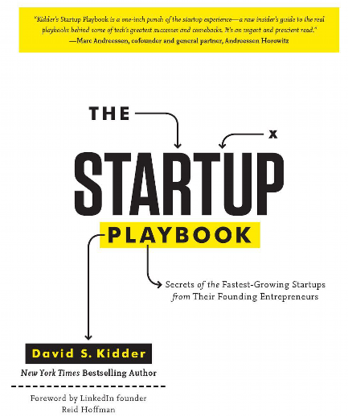
3. What’s the secret of the fastest-growing startups?
2
Filtering
Know Thyself
Play to your strengths (rarely do successful entrepreneurs chase market “whitespaces”)
Your startup must be rooted and flow from your innate gifts
Ruthlessly Focus on Your Biggest Ideas
When entrepreneurs identify a real trend, they lock on the One Big Idea
It is critical to select the problem well, focus intensely, and crack the code
Build Painkillers, Not Vitamins
Create the painkiller that will take away the hurt forever. Once customers start on your service or product, they never go off it.
Vitamins address problems in a holistic way, but they don’t take away pain.
Secrets of the Fastest-Growing Startups from their Founding Entrepreneurs
Be Ten Times Better
Be ten times better than your competitors. You cannot be incrementally better. Incrementalism kills companies.
Focus on an area of strength where you can be ten times better than anyone else in the world
Be a Monopolist
Thinking “monopolistically” means focusing on building market-dominating companies
Embrace this to aim for total market-domination
Taken from Kidder, David (2012-12-14). The Startup Playbook: Secrets of the Fastest-Growing Startups from their Founding Entrepreneurs

Slide 35
3. Filtering: your to-do guide
2
Filtering
1
Do a quick pass of ideas to see if there are any that can be grouped or removed
Quickly assess all your ideas based on fit & potential using the guiding
questions – just rough 1-10 as you read the questions for each idea
The template will map your ideas into 2x2 matrix
and identify your top 5 ideas in the top right corner
Next: Perform further research on top 5 ideas
2
Hi
Find your
Top 5 ideas
here!
3
Potential
Lo
Lo
Fit
Hi

Slide 36
4. Analysis: perform further research on top 5 ideas
3
Analysis
Why perform further research?
Validate the potential of the business idea
Further determine your excitement to work on each idea
Areas to research:
Customers
Who are your potential customers / customer segments? How big are they?
Is there need big enough? Is it a must-have or nice-to-have solution?
How easy and fast is it to make customers adopt your solution?
Are your customers willing to pay for a solution?
Competition
How are customers currently solving this need? What are the strengths and weaknesses to these methods?
How would you clearly differentiate your solution? How far can you do this?
Can you build entry barriers for additional competitors?
Feasibility
What are the key assumptions, technologies, or resources that your idea relies on that makes it different than how things are today? How difficult will it be to test those assumptions, build the technology or obtain the resources?
Is there a risk that you would get your offering to market past the opportunity / trend?
Has this or something similar been tried before? What can you learn from that?

Slide 37
Your to-do guide: Analysis
3
Analysis
1
Make notes for each of customers, competition and feasibility on each your top 5 business ideas by answering the questions on the previous page
Complete each analysis box by assessing, on a scale of 1-10, the attractiveness of the dimension: given these conditions, how attractive is this customer base? Competitive landscape? How easily implementable is it?
Submit / upload this completed assignment to Edmodo by July 3
Pick your best / favorite idea and prepare to deliver a one minute elevator pitch to deliver on the first day at Launch (does not need to be uploaded). Good luck!
Download and complete all tabs of this template
2
3
4

Slide 38

What is an Elevator Pitch?
As mentioned on the previous slide, each of you will have one minute to pitch a single business idea to your classmates.
The “elevator pitch” - if you ran into someone in / at the elevator and had the short time while the doors were closed to tell him/her about your idea, what are the most important things you would tell?
Your name, and the company’s / idea’s mission
A brief articulation of your customer need
An explanation of your idea
Why your idea adds value and addresses the customer need
Check out this youtube video for additional advice
Keep in mind that the idea you pitch will most likely not be the idea you pursue during the summer. This is intended as an exercise in pitching. Get in the habit of asking difficult questions, being deeply critical of your ideas, and being action-oriented, open-minded, and adjusting as needed.
Notes are not allowed – as the purpose of the exercise is to become comfortable talking about an idea to someone who you just ran into, in a succinct way. Make sure your pitch is under 1 minute. The “elevator doors” will shut at exactly 60 seconds!

Slide 39
End of Document

